Slide 1
Tai Chi App
A companion app for Learners of TAI CHI

Slide 2
Disclaimer
This product plan is for demo purposes only
This product plan is intended to be used as a template for real products
This is not a real product

Slide 3






About Me
Senior Product Owner
Scrum.org
Professional Scrum
Product Owner
2018
Scrum Alliance
Certified Scrum
Product Owner
2020
Scrum Alliance
Advanced Certified Scrum
Product Owner
2020
Technical Product Owner
Sun Certified
Programmer for the
Java 2 Platform
2000
Oracle Certified Professional
Java SE 7
Programmer
2012
Amazon Web Services
Associate
Solutions Architect
2020

Slide 4
Vision Statement
For students of Tai Chi
Who have difficulty practicing the set at home,
The Tai Chi companion app
Is a natural language Tai Chi guide
That verbally guides you through the set
Unlike other apps that require you to break form to interact with a screen.

Slide 5
Benefits of Tai Chi
Improve strength, balance, and flexibility
Boost cognitive function
Improves COPD symptoms
Improves sleep quality
Improves symptoms of fibromyalgia
Prevents falls
Reduces prenatal depression, anxiety and sleep disturbances
Helps with chronic nonspecific neck pain
Spiritual benefits
Promotes east/west cultural exchange

Slide 6






Tai Chi Demo!

Slide 7
Moves
1. Opening of Tai Chi
2. Left Grasp Bird's Tail
3. Grasp Bird's Tail
4. Single Whip
5. Step Up and Raise Hands
6. White Stork Spreads Wings
7. Brush Knee (left)
8. Strum the Pei Pa
9. Brush Knee and Twist Step (left)
10. Brush Knee and Twist Step (right)
11. Brush Knee (left)
12. Strum the Pei Pa
13. Brush Knee and Twist Step (left)
14. Chop with Fist
15. Step Up, Deflect, Parry, Punch
16. Appear to Close Entrance
17. Cross Hands
18. Carry Tiger to Mountain
19. Whip Out Diagonally
20. Fist Under Elbow
21. Go Back to Ward Off Monkey (right)
22. Go Back to Ward Off Monkey (left)
23. Go Back to Ward Off Monkey (right)
24. Flying at a Slant
25. Step Up and Raise Hands
26. White Stork Spreads Wings
27. Brush Knee (left)
28. Push Needle to Sea Bottom
29. Fan Penetrates through the Back
30. Turn and Chop with Fist
31. Step Up, Deflect, Parry, Punch
32. Step Up to Grasp Bird's Tail
33. Single Whip
34. Move Hands Like Clouds (five times)
35. Single Whip
36. Reach Up to Pat Horse
37. Separate Foot to Right
38. Separate Foot to Left
39. Turn and Kick
40. Brush Knee and Twist Step (left)
41. Brush Knee and Twist Step (right)
42. Step Up and Punch
43. Turn and Chop with Fist
44. Step Up, Deflect, Parry, Punch
45. Right Foot Kick
46. Hit Tiger at Left
47. Hit Tiger at Right
48. Right Foot Kick
49. Strike Ears with Fists
50. Left Foot Kick
51. Turn and Kick
52. Chop with Fist
53. Step Up, Deflect, Parry, Punch
54. Appear to Close Entrance
55. Cross Hands
56. Carry Tiger to Mountain
57. Whip Out Horizontally
58. Parting Wild Horse's Mane (right)
59. Parting Wild Horse's Mane (left)
60. Parting Wild Horse's Mane (right)
61. Parting Wild Horse's Mane (left)
62. Parting Wild Horse's Mane (right)
63. Left Grasp Bird's Tail
64. Step Up to Grasp Bird's Tail
65. Single Whip
66. Fair Lady Works Shuttles (left)
67. Fair Lady Works Shuttles (right)
68. Fair Lady Works Shuttles (left)
69. Fair Lady Works Shuttles (right)
70. Left Grasp Bird's Tail
71. Step Up to Grasp Bird's Tail
72. Single Whip
73. Move Hands Like Clouds (seven times)
74. Single Whip
75. Creeping Low Like a Snake
76. Golden Cock Stands on One Leg (left)
77. Golden Cock Stands on One Leg (right)
78. Go Back to Ward Off Monkey (right)
79. Go Back to Ward Off Monkey (left)
80. Flying at a Slant
81. Step Up and Raise Hands
82. White Stork Spreads Wings
83. Brush Knee (left)
84. Push Needle to Sea Bottom
85. Fan Penetrates through the Back
86. White Snake Turns and Puts Out Tongue
87. Step Up, Deflect, Parry, Punch
88. Step Up to Grasp Bird's Tail
89. Single Whip
90. Move Hands Like Clouds (three times)
91. Single Whip
92. Reach Up to Pat Horse
93. Cross Hands to Penetrate
94. Turn and Kick
95. Chop with Fist
96. Brush Knee and Punch
97. Step Up to Grasp Bird's Tail
98. Single Whip
99. Creeping Low Like a Snake
100. Step Up to Seven Stars
101. Retreat to Ride Tiger
102. Turn Around to Sweep Lotus
103. Draw Bow to Shoot Tiger
104. Chop with Fist
105. Step Up, Deflect, Parry, Punch
106. Appear to Close Entrance
107. Cross Hands
108. Closing of Tai Chi

Slide 8
Opportunity
Learning Tai Chi requires both in-person instruction and home practice, but due to the complexity of the set, it is a challenge for people to remember all the moves in the set when practicing at home.
This app will act as a study aid to guide the user through all the moves, to supplement in-person instruction.
Basically, it helps you remember the set.

Slide 9
Differentiator
Natural Language User Interface
No need to turn your head to look at a screen
No need to break form to interact with a touchscreen or mouse
Takes advantage of emerging technologies
  Smart Speakers: Amazon Echo, Google Home
  Digital Assistants: Siri, Google Assistant, Alexa
  Smart Watches: Apple Watch, Fitbit, Garmin
Portable and unobtrusive, enables practice with headphones in the park

Slide 10
MARKET ANALYSIS
8 Organizations currently operating
in Toronto that are 100% dedicated to teaching Tai Chi
377 Fung Loi Kok Taoist Tai Chi Locations in Ontario
$9,000,000 Fung Loi Kok Taoist Tai Chi Canadian Revenue 2017
$44,500,000 Fung Loi Kok Taoist Tai Chi Assets
31 International Fung Loi Kok Taoist Tai Chi branches globally
in addition to Canada

Slide 11
Risks
People misunderstand the concept and think the app will teach them Tai Chi without in-person instruction
People would prefer a simple mp3 or YouTube video
The technology may not yet be mature enough to be easy to use (Alexa, Google Home, Siri, Text-to-speech)
The target market may not be technologically savvy enough to use this type of app
Tai Chi studios might feel threatened, or think that this app competes with in-class instruction
Tai Chi studios may claim intellectual property on the text used to explain moves

Slide 12
Concierge MVP
Before proceeding further, we can do an MVP right now:
Count how many moves a person can do without guidance
Count how many moves a person can do with someone reading out the moves to them
Count how many moves a person can do with someone reading the out moves to them, AND explaining the move verbally, from a script, if prompted
Repeat with more people
If the number of moves increases consistently, we have a worthy product idea.

Slide 13
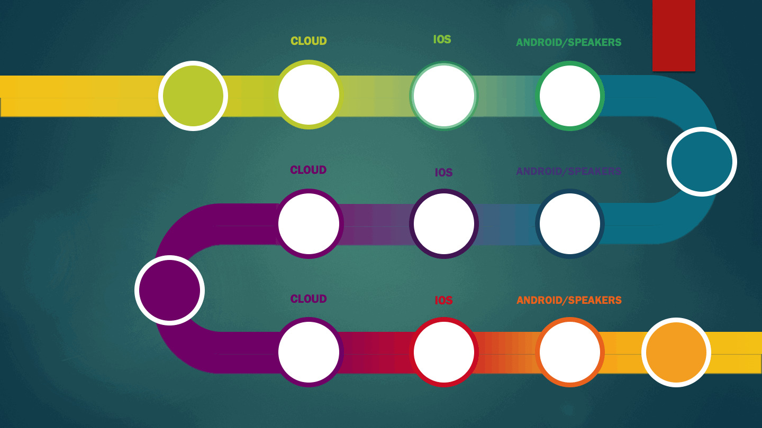
ROADMAP PAGE 1/2
Audio
Generation
Spike
iOS App
Spike
Android App
Spike
INITIATION
DISCOVERY
REST
API
Apple
Watch
Spike
Smart
Speaker
Spike
DESIGN
DATABASE
iOS App
Android App
MVP

Slide 14
ROADMAP PAGE 2/2
2
SECURITY
Auth &
Personalization
Auth &
Personalization
Auth &
Personalization
Expansion
Scalability
Reliability
Apple
Watch
App
Smart
Speaker
App
FEATURES
FEATURES
FEATURES
FEATURES
MORE
FEATURES

Slide 15
Additional Info in Product Plan
Competitors
Potential Partners
Potential Revenue Models
Other markets: Dance Choreography
Benefits of Tai Chi Referenced
Customer Research
Risk Analysis
Market Analysis Referenced
Tai Chi Studios in Toronto Referenced
Customer Journey (simplified)
Persona
Customer Journey Map (Simplified)
Assumptions
User Stories (sample)
Epic Goals
  Initiation
  Discovery
  MVP
  Security & Customization
  Expansion
  Features
Next Steps

Slide 16


THANKS FOR YOUR
TIME, Randy

